Slide 1


Women & Social Inclusion
Post-2015 Sustainable Development Goals
Sascha Gabizon
WECF International
Women‘s Major Group

Slide 2
Sustainable Development Goals result from other UN process (Rio+20)
Universal (not just for developing countries)
15 years (2015-2030)
Measurable (indicators key)
Ambitious and transformative
Address root causes of inequalities
Implementable (Means of Implementation)
Notes:
The 2012 Human Development Report, however, warns that if environmental degradation continues at the current rate, these gains in poverty reduction will be entirely turned back, pulling over 3 billion people back into extreme poverty. And women will still be the majority of these 3 billion.
The current economic system creates greater inequities. There are more billionaires then ever both in the North as in the South. The 100 richest people in the world added 240 billion dollars to their wealth in 2012.
While the wealthy consume more natural resources and are responsible for increasing levels of environmental damage, the poor are suffering from degradation of their agricultural land, forests, water supplies and biodiversity, and alteration of natural weather cycles due to climate change.

Slide 3
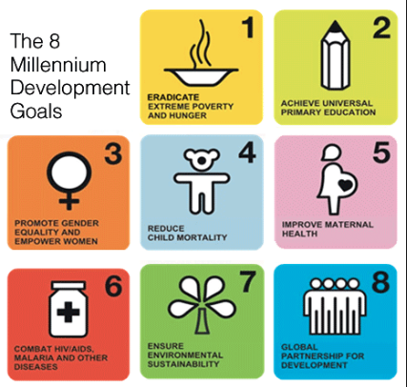
Millennium Development Goals
The MDGs: very aggregated, hide inequalities in EECCA region

Slide 4
End of the “Trickle Down” Myth
MDG’s aimed at halving extreme poverty
MDG has not been achieved
Despite progress in GDP, majority of population no progress
What did increase is inequality, more rich people

Slide 5
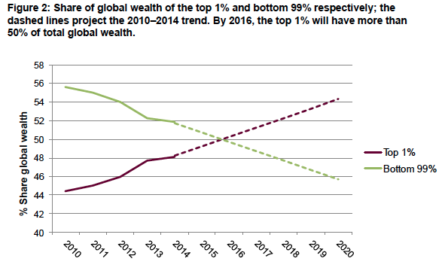
Inequality core issue for Post2015
Oxfam report “Wealth: Having it all and wanting more”
The combined wealth of the richest 1 per cent will overtake that of the other 99 per cent of people next year

Slide 6
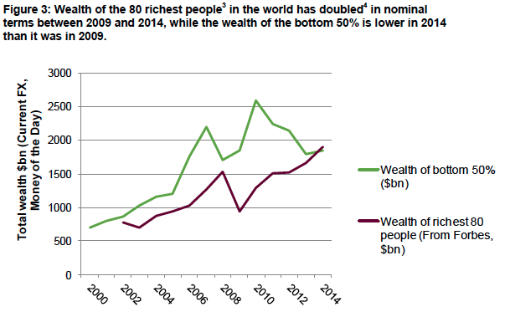
Inequality – concentration of power
The 80 richest individuals now have the same wealth as the bottom 50% of the world’s population (in 2010 were still 388 people)
There is increasing evidence from the e.g. International Monetary Fund, that extreme inequality is not just bad news for those at the bottom but also damages economic growth.

Slide 7
Intra and inter-Country Inequality, 2007
Constant US$, 2000 value
Source: Ortiz and Cummins (2011) UNICEF
Source: Ortiz and Cummins. 2011. Global Inequality. UNICEF
Notes:
Each vertical column represents the income of one quintile of one country. Here, the tallest block in the back corner reflects the income of the richest quintile of the population of Luxembourg, while the column that is barely discernible in the nearest left-hand corner represents the income of the poorest quintile of the population of the Democratic Republic of Congo. In simplifying the message, one can see that the richest quintile of the population of the richest country has 100 000 times the income of the poorest group in the poorest country.
The figure is based on data for 135 countries as of 2007 using constant 2000 U.S. dollars.
Source: Isabel Ortiz and Matthew Cummins. 2011. Beyond the Bottom Billion, Global Inequality. UNICEF. www.unicef.org/socialpolicy/index_58230.html

Slide 8
Power to lobby policy makers
Elite groups mobilise their vast resources to ensure global rules are favourable towards their interests.
20% of billionaires have interests in the financial and insurance sectors. These sectors spent $550m lobbying policy makers in Washington and Brussels during 2013
Billionaires of the pharmaceutical and healthcare sectors saw their collective net worth increase by 47 %. During 2013, they spent more than $500m lobbying policy makers in Washington and Brussels

Slide 9
Inequalities barrier to implementation of Post2015 agenda
Inequalities in wealthy countries barrier to implementation of SDGs
Race to the bottom, increases nb of people in poverty
Funds needed from increasing ODA funding from OECD countries – not charity
Median income has stagnated for decades at poverty line of less than 2$ per day – despite MDGs
Even though economic growth in many countries, majority of population has not seen increase income

Slide 10
What works to reduce inequalities?
Social protection floors
  Minimum income guarantee
  Universal, free public services, health, education, housing, water
    example Brazil 50 million people out of poverty in Lula’s presidency period
Share the tax burden fairly, shifting taxation from labour and consumption towards capital and wealth
  Introduce financial transaction taxes a.o.
Introduce minimum wages and ensure a living wage for all workers
Introduce equal pay legislation and promote economic policies to give women a fair deal
Reduce and redistribute women’s burden of unpaid work
Stop tax dodging by corporations and rich individuals
Debt restructuring and relief !!

Slide 11
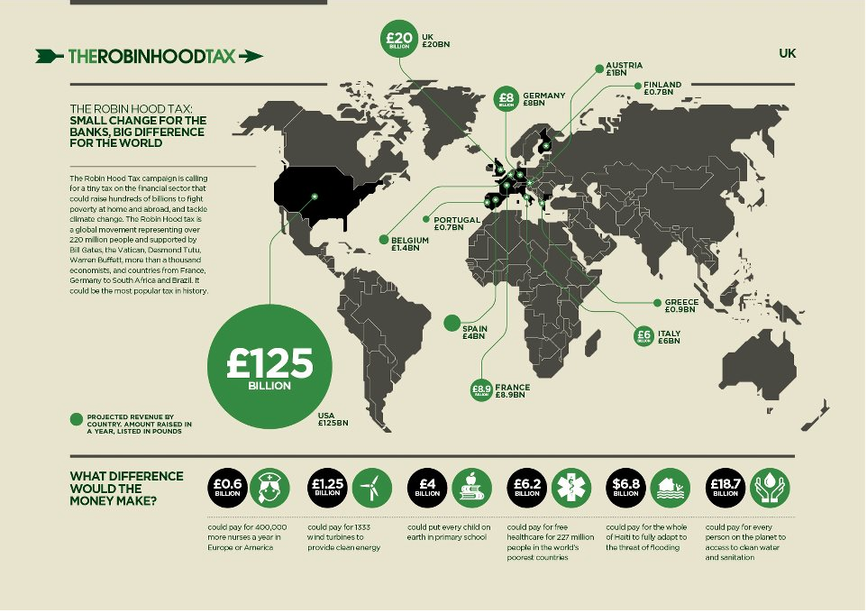
Example of Fin. Transaction Tax

Slide 12
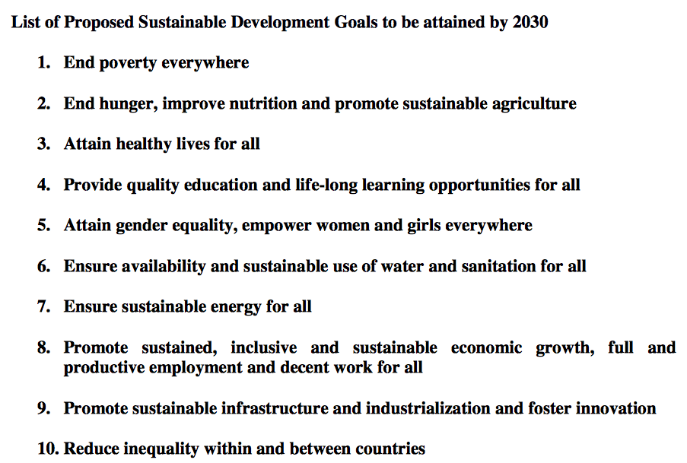
17 Sustainable Development Goals (1.7.14)

Slide 13
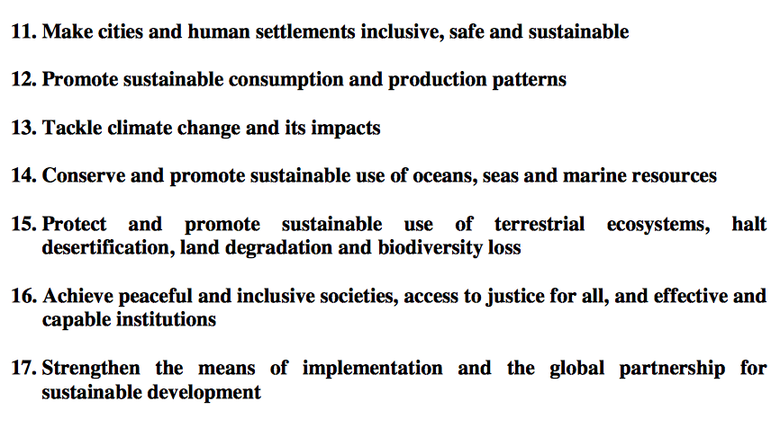
17 SDG goals (continued)

Slide 14


Sustainable Development Goals dealing specifically with inequality

Slide 15
Goal 1. End poverty in all its forms everywhere
1.1 by 2030, eradicate extreme poverty for all people everywhere, currently measured as people living on less than $1.25 a day
1.2 by 2030, reduce at least by half the proportion of men, women and children of all ages living in poverty in all its dimensions according to national definitions
1.3 implement nationally appropriate social protection systems and measures for all, including floors, and by 2030 achieve substantial coverage of the poor and the vulnerable
1.4 by 2030 ensure that all men and women, particularly the poor and the vulnerable, have equal rights to economic resources, as well as access to basic services, ownership, and control over land and other forms of property, inheritance, natural resources, appropriate new technology, and financial services including microfinance
1.5 by 2030 build the resilience of the poor and those in vulnerable situations, and reduce their exposure and vulnerability to climate-related extreme events and other economic, social and environmental shocks and disasters
1.a. ensure significant mobilization of resources from a variety of sources, including through enhanced development cooperation to provide adequate and predictable means for developing countries, in particular LDCs, to implement programmes and policies to end poverty in all its dimensions
1.b create sound policy frameworks, at national, regional and international levels, based on pro-poor and gender-sensitive development strategies to support accelerated investments in poverty eradication actions

Slide 16
Goal 5. Achieve gender equality and empower all women and girls
5.1 end all forms of discrimination against all women and girls everywhere
5.2 eliminate all forms of violence against all women and girls in public and private spheres, including trafficking and sexual and other types of exploitation
5.3 eliminate all harmful practices, such as child, early and forced marriage and female genital mutilations
5.4 recognize and value unpaid care and domestic work through the provision of public services, infrastructure and social protection policies, and the promotion of shared responsibility within the household and the family as nationally appropriate
5.5 ensure women’s full and effective participation and equal opportunities for leadership at all levels of decision-making in political, economic, and public life
5.6 ensure universal access to sexual and reproductive health and reproductive rights as agreed in accordance with the Programme of Action of the ICPD and the Beijing Platform for Action and the outcome documents of their review conferences
5.a undertake reforms to give women equal rights to economic resources, as well as access to ownership and control over land and other forms of property, financial services, inheritance, and natural resources in accordance with national laws
5.b enhance the use of enabling technologies, in particular ICT, to promote women’s empowerment
5.c adopt and strengthen sound policies and enforceable legislation for the promotion of gender equality and the empowerment of all women and girls at all levels

Slide 17
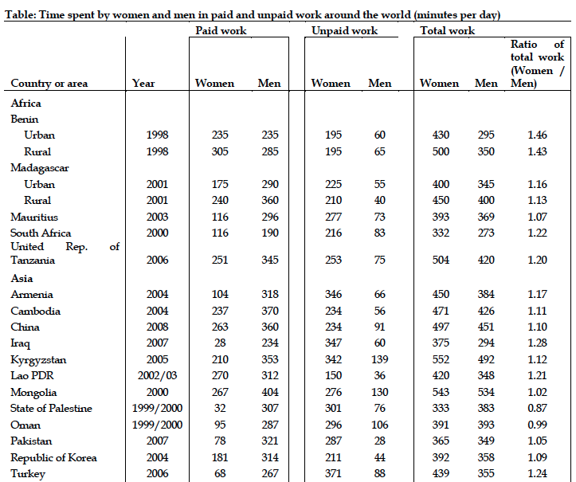
Notes:
Women in Turkey work 22% more hours than men
Married women with university level – 10% - are above 70% in the labor market
Unmaried women, 50% of all qualifications . are in labor market.
So it is not a question of education. It is a question of inequality within the household.

Slide 18
Goal 10. Reduce inequality within and among countries
10.1 by 2030 progressively achieve and sustain income growth of the bottom 40% of the population at a rate higher than the national average
10.2 by 2030 empower and promote the social, economic and political inclusion of all irrespective of age, sex, disability, race, ethnicity, origin, religion or economic or other status
10.3 ensure equal opportunity and reduce inequalities of outcome, including through eliminating discriminatory laws, policies and practices and promoting appropriate legislation, policies and actions in this regard
10.4 adopt policies especially fiscal, wage, and social protection policies and progressively achieve greater equality
10.5 improve regulation and monitoring of global financial markets and institutions and strengthen implementation of such regulations
10.6 ensure enhanced representation and voice of developing countries in decision making in global international economic and financial institutions in order to deliver more effective, credible, accountable and legitimate institutions
10.7 facilitate orderly, safe, regular and responsible migration and mobility of people, including through implementation of planned and well-managed migration policies
10.a implement the principle of special and differential treatment for developing countries, in particular least developed countries, in accordance with WTO agreements
10.b encourage ODA and financial flows, including foreign direct investment, to states where the need is greatest, in particular LDCs, African countries, SIDS, and LLDCs, in accordance with their national plans and programmes
10.c by 2030, reduce to less than 3% the transaction costs of migrant remittances and eliminate remittance corridors with costs higher than 5%

Slide 19
Social Protection
1.3 implement nationally appropriate (BAD) social protection systems and measures for all, including floors (GOOD), and by 2030 achieve substantial coverage of the poor and the vulnerable

Slide 20
Economic rights
1.4 by 2030 ensure that all men and women, particularly the poor and the vulnerable, have equal rights (GREAT) to economic resources, as well as access to basic services, ownership, and control over land and other forms of property, inheritance, natural resources, appropriate new technology, and financial services including microfinance

Slide 21
Resilience & Climate
1.5 by 2030 build the resilience of the poor and those in vulnerable situations, and reduce their exposure and vulnerability to climate-related extreme events and other economic, social and environmental shocks and disasters (GREAT)
13.b Promote mechanisms for raising capacities for effective climate change related planning and management, in LDCs, including focusing on women, youth, local and marginalized communities (GREAT)

Slide 22
Gender sensitive planning
1.b create sound policy frameworks, at national, regional and international levels, based on pro-poor and gender-sensitive development strategies (GOOD) to support accelerated investments in poverty eradication actions

Slide 23
Unpaid work
5.4 recognize and value (we lost reduce and redistribute) unpaid care and domestic work through the provision of public services, infrastructure and social protection policies, and the promotion of shared responsibility within the household (up to here GREAT) and the family as nationally appropriate (rest BAD)

Slide 24
Gender MOI
5.a undertake reforms to give women equal rights to economic resources, as well as access to ownership and control over land and other forms of property, financial services, inheritance, and natural resources (GREAT!) in accordance with national laws (BAD)
5.b enhance the use of enabling technologies, in particular ICT, to promote women’s empowerment
5.c adopt and strengthen sound policies and enforceable legislation for the promotion of gender equality and the empowerment of all women and girls at all levels

Slide 25
Equal pay for work equal value
8.5 by 2030 achieve full and productive employment and decent work for all women (GREAT) and men, including for young people and persons with disabilities, and equal pay for work of equal value (GREAT)

Slide 26
Reducing Inequalities
10.1 by 2030 progressively achieve and sustain income growth of the bottom 40% of the population at a rate higher than the national average (GREAT: means redistribution policies!)
10.2 by 2030 empower and promote the social, economic and political inclusion of all irrespective of age, sex, disability, race, ethnicity, origin, religion or economic or other status (GREAT!!)

Slide 27
Eliminate discriminatory laws
10.3 ensure equal opportunity and reduce inequalities of outcome, including through eliminating discriminatory laws, policies and practices and promoting appropriate legislation, policies and actions in this regard (GREAT)
10.4 adopt policies especially fiscal, wage, and social protection policies and progressively achieve greater equality (GREAT, we almost lost this)

Slide 28
Public transport, services
11.1 by 2030, ensure access for all to adequate, safe and affordable housing and basic services, and upgrade slums (GREAT!!)
11.2 by 2030, provide access to safe, affordable, accessible and sustainable transport systems for all, improving road safety, notably by expanding public transport, with special attention to the needs of those in vulnerable situations, women, children, persons with disabilities and older persons (GOOD!)

Slide 29
Now its all about Addis ! CSO ask:
Systemic Change global financial systems
  Debt relief & restructuring UN Resolution
  UN tax cooperation inter-governmental body
  Basic global corporate tax rate, Social protection floor & Universal health coverage and insurance
  Gender budgeting for all budgets
  Earmarked funds for women’s rights organisations, cooperatives and social enterprises
  Specific windows/access for women to all development and climate funds
  Eliminate Trade Agreement, Investor Protection which negatively impact women’s rights
  UN Technology Facilitation Mechanism + Assessment
  Delete references to PPPs and blended finance

Slide 30
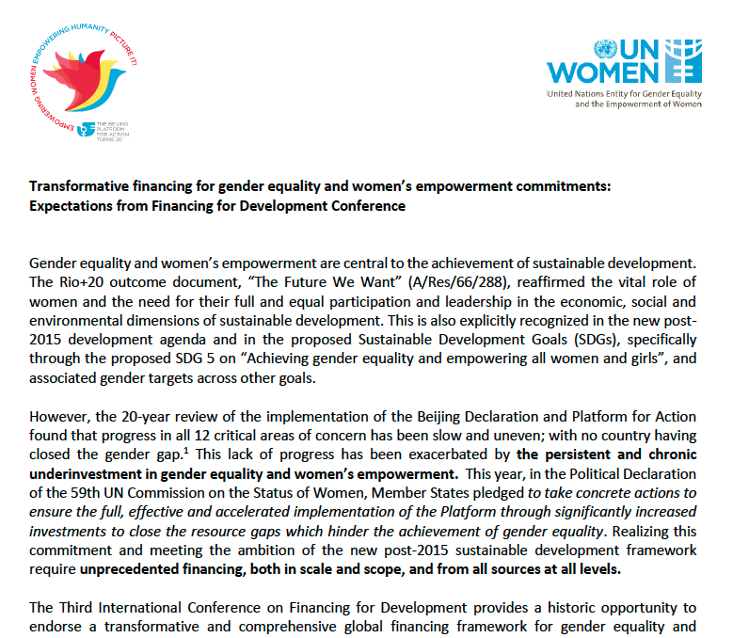
UNWOMEN: Key Messages on Financing for Devlopment

Slide 31
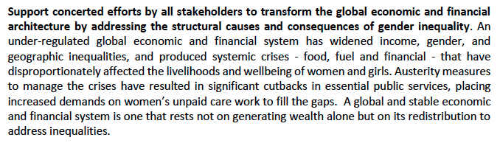
Dysfunctional global financial system
UNWOMEN:
Redistribution not Austerity !

Slide 32
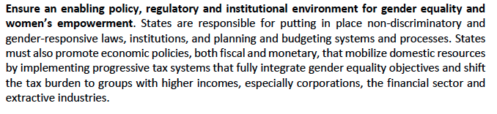
Progressive tax systems
UNWOMEN:
shifting burden away from poor & women to corporations, especially financial and extractive sectors !!

Slide 33
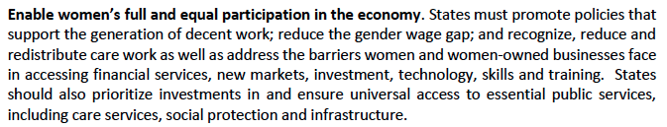
Social Protection & Unpaid care work
UNWOMEN:
Ensure social protection floors – specifically focussed on women (eg. Brazil)
Bring back into FFD draft & 31 the ILO Convention 102, and the accompanying Recommendation 202 and as elaborated by the UN CESCR under General Comment 19

Slide 34
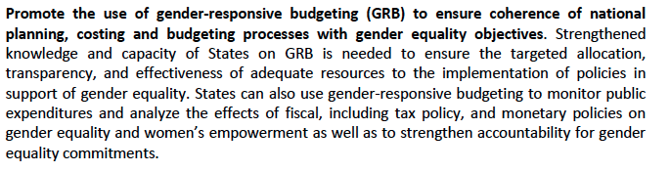
Gender Responsive Budgeting
UNWOMEN:
Add „Gender Responsive Budgeting“ to FfD &27!

Slide 35
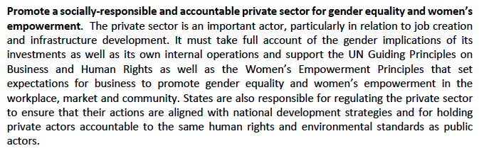
Regulate Private Sector to not harm
UNWOMEN:
Regulate private sector to uphold Women human rights !
Review all investor protection clauses, tax rulings, trade agreements!
Social, Environmental and Women rights safe guards !

Slide 36
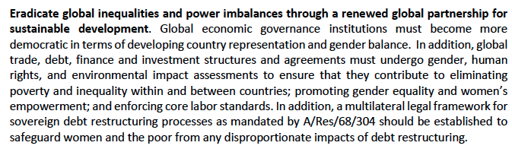
Global Partnership & reform Int‘l Trade
UNWOMEN:
Gender Equality and Women‘s human rights Safeguards for all trade and investor agreements!
Implement UN Debt relief and restructuring body
Create intergovernmental UN Tax coordination body

Slide 37
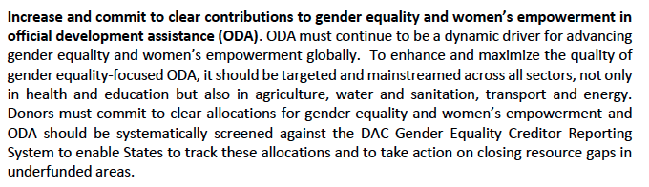
ODA to Gender Equality/Women rights
UNWOMEN:
Gender criteria and budget allocation for all ODA funds!
Specific dedicated women‘s rights funds but NOT via the World Bank!

Slide 38
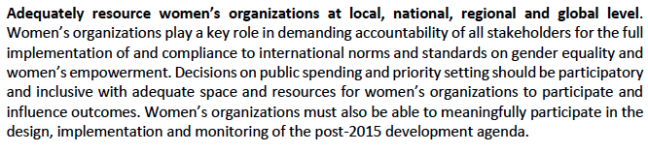
Space and Funds for Women‘s Organisations
UNWOMEN:
Add to FFD:
„Dedicated“ funding for civil society women‘s rights organisations (not blended with private sector!)
Observer seat for Women’s organisations in negoitations

Slide 39
2nd zero draft Addis 6 May 2015
Gender Equality and Women‘s and Girls Empowerment
  In Opening Paragraph
  Para 6 Gender Para, incl mention “women’s rights”
  Para 12 Ending hunger, gender equality, women
  Para 18 Domestic policies, formal employment
  Para 27 Gender Equality Women’s Empowerment National plans, budgets (NEW)
  Para 38 Women access to public and private finance and ref to UNCDF (NEW)
  Para 40 Women Equal Economic Rights
  Para 95 IMF+WB gender-balance in selection leaders (NEW)
  Para 98 Women human rights to be respected by IFIs
  Para 100 human trafficking, women(NEW) & children
  Para 103 Technology for social inclusion (NEW) Gender Equality
  Para 115 + 116 Gender Disaggregated data (NEW)
New: reference to UN Guiding Principles on Business and Human Rights (&36)
New: progressive taxation (&19)
New: UN Technology Facilitation Mechanism “if agreed” (from SDGs)
Missing: no specific reference to “GENDER BUGETTING” as a term

Slide 40
Paragraph 6 Gender, Women&Girls
6. We reaffirm that achieving gender equality and women’s empowerment areempowering all women and girls is essential to achieve equitable and effective sustainable growth and development. We reiterate the need for gender mainstreaming in the formulation and implementation of all financial and, economic, and social policies and agree to implement transformativetake concrete policy actions to ensure women’s equal rights, access and opportunities for participation and leadership in the economy

Slide 41
Paragraph 12, Ending hunger
12. Scaling up efforts to end hunger: It is unacceptable that more than 800 million people are chronically undernourished and do not have access to safe and nutritious food. Investments in nutrition, rural development and sustainable agriculture are essential for eliminating hunger, achieving food security and nutrition, creating decent job opportunities, in particular for rural youth and women, and fisheries will lead to rich payoffs across the SDGs. Agriculture is primarilyEnding hunger will ultimately depend on increasing incomes, and in the short term this can come about through higher smallholder productivity. We recognize the enormous needs for investment in agriculture, food production, and fisheries. This will primarily be financed through private sources, and we encourage increased private investments, in accordance with the Committee on World Food Security’s (CFS) voluntary Principles for Responsible Investment in Agriculture and Food Systems. At the same time we commit to put in place policies to ensure the sustainability and growth of agriculture.However, public investments in agriculture and nutrition must play a strategic role, particularly in financing research, infrastructure and pro-poor initiatives. We agree to substantially increase public investment in areas such as rural infrastructure, agricultural research, including tropical agriculture, sustainable food production and food systems, with a particular focus on small scale food producers and on promoting gender equality to attain food security and nutrition for the poorest and most vulnerable. We will further catalyse progress through strengthened policy frameworks to encourage access to markets for farmers, with a particular attention to smallholder and women farmers and a fair multilateral trading system, with a focus on smallholders, agricultural cooperatives and farmers´ networks, the multi-dimensional challenge of nutrition and promoting gender equality and empowerment of women. These efforts must be supported by enabling domestic and international environments.

Slide 42
Paragraph 18+19 domestic tax policies
18. We agree to incorporate sustainable development, and promote equity, including gender equality, as an objective in all tax and revenue policies, including incentives we give to domestic and foreign investors, and tax treaties and agreements.women and girls’ empowerment, and social inclusion as an objective in our domestic policies. We will promote and enforce non-discriminatory laws. Countries should promote social infrastructure and policies to enable women’s full participation in the economy. The full and equal participation of women, youth and persons with disabilities in the formal labour market would significantly increase their economic empowerment and their contributions to economic growth. To support the generation of jobs, we agree to develop and operationalize, by 2020, a global strategy for youth employment and implement the ILO Global Jobs Pact.
While many countries have made considerable progress in strengthening fiscal management since the Monterrey Consensus, we recognize that significant additional public resources will be necessary to realize sustainable development and achieve the SDGs. Towards that end we are committed to bolstering government revenues as needed while improving the efficiency of our expenditures. Countries with government revenue below 20 per cent of GDP agree to progressively increase tax revenues, with the aim of halving the gap towards 20 per cent by 2025, and countries with government revenue above 20 per cent of GDP agree to raise tax revenues as appropriate. Globally, we commit to 19. We commit to enhance revenue administration through modernized, progressive tax systems, improved tax policy capacity and more efficient tax collection, as well as improve the fairness, transparency and effectiveness of our tax systems, including through broadening the tax base and continuing efforts to integrate the informal sector into the formal economy in line with country circumstances. As part of their national sustainable development strategies, we encourage countries to set nationally defined domestic revenue targets, and aim to reach them by 2025 .

Slide 43
Paragraph 27 National plans/budget
27. We will spend our resources efficiently and effectively, and in support of country-owned national sustainable development strategies and the SDGs. We will ensure that our national policies are in line with good governance, accountability and gender-sensitive and public financial management, and promote equity. promote equity, gender equality and women’s and girls’ empowerment, good governance and accountability at all levels. We will strengthen national control mechanisms, such as supreme audit institutions, along with other independent oversight institutions, as appropriate. We will increase transparency and participation in all aspects of the budgeting process, and encourageinvite those who have not yet done so to join the Open Government Partnership. We further agree on the need for to establish transparent public procurement that reinforcesframeworks as a strategic tool to reinforce sustainable development.

Slide 44
Para 38 Women access fin+UNCDF
38. We will work to ensure access to formal financial services for all, including the poor, women, rural communities, indigenous people, and persons with disabilities. We will adopt or review our national financial inclusion strategies in consultation with relevant national stakeholders, and include financial inclusion and consumer protection as a policy targets in financial regulation. We will encourage our commercial banking systems to serve all populations. We will support microfinance institutions, development banks, agricultural banks, mobile network operators, payment platforms, agent networks, cooperatives, postal banks and savings banks. We encourage the use of innovative tools, including mobile banking and digitalized payments to promote inclusion and financial literacy. We commit to increasing resources for capacity development for developing countries and expand peer learning and experience sharing among countries and regions, including through the Alliance for Financial Inclusion and regional organizations. We encourage mutual cooperation and collaboration between financial inclusion initiatives, including the Consultative Group to Assist the Poor (CGAP), the Global Partnership for Financial Inclusion (GPFI) and the United Nations Capital Development Fund (UNCDF).

Slide 45
Paragraph 40 FfD3
40. Evidence shows that gender equality, women’s empowerment and women’s full participation as economic agents improves the profitability and competitiveness of business and is vital to achieve sustainable development and a vibrant economy. To this end, we reaffirm our commitmentenhances economic growth and productivity. We recommit to adopt and strengthen sound policies and enforceable legislation for the promotion of gender equality and the empowerment of all women and girls at all levels, and to eliminate gender-based discrimination in all its forms. We commit towill ensure that by 2030 all men and women, in particular the poor and the vulnerable, have are given equal rights to economic resources opportunities, as well as access to basic services, ownership and control over land and other forms of property, inheritance, natural resources, appropriate new technology and financial services, including microfinance.. We further encourage the private sector to contribute to advancing gender equality through ensuring women’s full and decent employment work, equal pay and equal opportunities., including opportunities to participate in leadership and decision-making, as well as protecting them against discrimination and abuse in the workplace.

Slide 46
Paragraph 94 reform IFIs
94. We agree on the needrecommit to respect each country’s policy spacebroadening and leadership to establishstrengthening the voice and implement policies for poverty eradicationparticipation of developing countries in international economic decision-making and norm setting and global economic governance. We agree to overcome obstacles to planned resource increases and governance reforms at the IMF. sustainable development. In this regard, we recognize the importance of capital account and macro prudential regulations, and will strengthen our support for capacity-building in monitoring, analyzingThe implementation of the 2010 reforms for the IMF remains the highest priority and we strongly urge the earliest ratification of these reforms. We reiterate our commitment to further reform in voting shares and representation in both the IMF and the World Bank. We welcome the increased representation of emerging economies on the FSB and call upon the Basel Committee on Banking Supervision and other main international regulatory standard setting bodies to continue efforts to increase the voice and participation of developing countries, including in all of their subsidiary committees, to ensure that their concerns and conditions are taken into consideration. As the shareholders in the main international financial institutions, we commit to open and transparent, gender-balanced and merit-based selection of their heads.

Slide 47
Paragraph 98 IFIs + women rights
98. We resolve to ensure that international agreements, rules and standards are consistent with each other and with progress towards the SDGs, for example, those for trade, intellectual property rights, banking and insurance regulation, balance-of-payments management and accounting standards. To this end, we invite relevant international institutions, as well as private rule-setting bodies, to undertake ‘coherence checks’ and regularly publish reviews of the impact of their operations on the achievement of economic, social and environmental priorities and in particular the SDGs. We encourage all international and national development finance institutions to align their business practices with sustainable development objectives, including through assessments of their impact on the enjoyment of human rights, including indigenous peoples' rights, progress toward gender equality, and ESG targets that they have adopted. We further invite all relevant international institutions to recognize the group of LDCs, to fully reflect the importance of fragility and structural constraints in achieving the SDGs.the SDGs. We encourage all development finance institutions We recommit to broadening and strengthening the participation of developing and transition economy countries in international economic decision-making and norm setting. We agree to overcome obstacles to planned resource increases and governance reforms at the IMF. We welcome the expansion in the number of participants in meetings of the FSB and recommend consideration by the FSB, the Basel Committee on Banking Supervision and the other main international regulatory standard setting bodies to increase the voice and participation of developing countries, including in all of their subsidiary committees. As the shareholders in the main international financial institutions, we commit to open and transparent, gender-balanced and merit-based selection of their heads. Recognizing to align their business practices with the SDGs, including through assessments of their impact on the enjoyment of human rights, including women’s, children’s, and indigenous peoples' rights, and environmental, social and governance targets that they have adopted. We further call upon all relevant international institutions to recognize the groups of LDCs and SIDS, and to fully reflect the importance of vulnerability and structural constraints in achieving the SDGs.

Slide 48
Paragraph 100, trafficking
100. We also resolve to will strengthen national institutions and enhance international cooperation to prevent violence and combat terrorism and crime, and end trafficking and exploitation of children. In this context, wepersons, in particular women and children, including through international cooperation for capacity building at all levels, in particular in developing countries. We commit to ensuring the effective implementation of the United Nations Convention on Transnational Crime.

Slide 49
Paragraph 103, Technology
Technology103. Science, technology, innovation and capacity building are critical to achieving sustainable development. We are currently witness towitnessing significant advances in a wide range of science and technology fields, which, if harnessed properly, will enable great progress for people and planet., if properly harnessed. Innovation and diffusion of new technologies is a powerful driver of economic growth and employment creation. New vaccines and medicines will support advances in health. Information and communication technologies (ICT) drive technological progress in a wide range of sectors and have made the diffusion of information easier, which offers great opportunities for education. New technologies and technological diffusion will be key to attain more climate-resilient and resource-efficient development, including through low carbon energy sources and systems. TechnologyScience, technology, innovation and capacity building can also promote support social inclusion, gender equality and facilitate sustainable production and consumption patterns, resilience against natural disasters, climate change and other shocks, and support the protection of the environment, including preventing deforestation and desertification.. Innovation, including development, diffusion and transfer of technologies, and associated know-how, can be a powerful driver of sustainable development. However, we note with concern the uneven innovative capacity and access to technology both, including ICT, within and between countries, as shown for example by a and the persistent “‘digital divide”,divide’, particularly for LDCs., LLDCs, SIDS, and African countries.

Slide 50
Paragraph 115+116 Gender Disag.Data
115. High-quality disaggregated data is an essential input for smart and transparent decision-making. Data at the local, national, and global levels can enable governments, civil society, and the private sector to better target policy innovations and programs, improve services, spur innovation and growth, increase efficiency, and reduce costs. We will seek to increase significantly the availability of high-quality, timely and reliable disaggregated data, including by gender, in support of the post-2015 development and its means of implementation. A focus on data and statistical systems at the country level will be especially important in order to strengthen domestic capacity and accountability. Targeted support will be needed for this effort.
To reach the commitments agreed in this Accord, we commit, in particular,116. We will enhance capacity building support to assist countries in collecting developing countries, including for LDCs and SIDs, to increase significantly the availability of high-quality, timely and reliable disaggregated data, including by gender. We will assist developing countries in collecting disaggregated data on domestic flow of funds, including sources, uses and allocation to sustainable development activities by contributing to strengthen by strengthening national statistical authorities. We also request the UN Statistical Commission, working with the and bureau. We call on relevant international statistical services and forums, to facilitate enhanced tracking of data on all cross-border financing and other economically relevant flows that brings together existing databases,

Slide 51
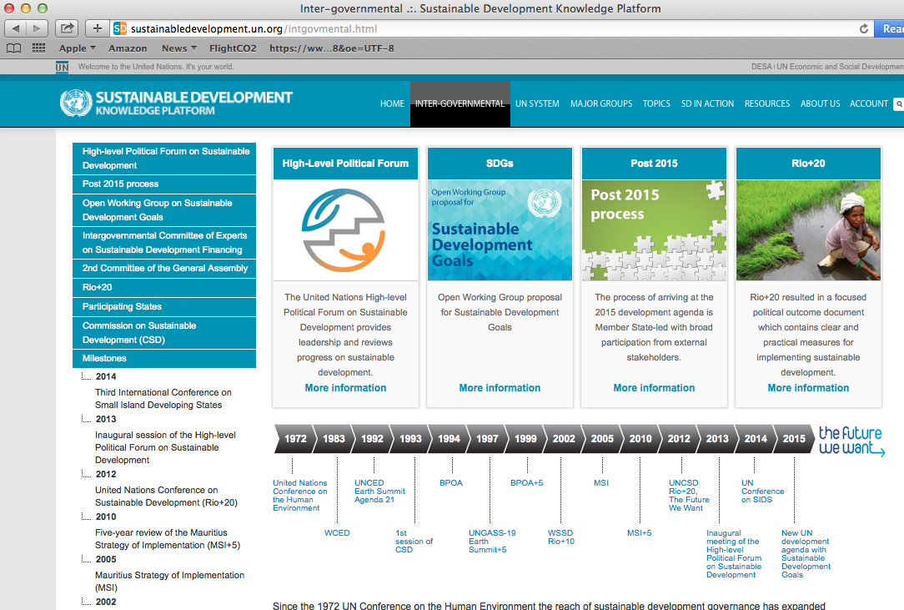
Notes:
Voluntary framework for development cooperation – to follow up on the MDGs (who knows ?)
Why such interest? – little pot of 100 billion of ODA spending per year – but has been going down
Some African countries almost 20% of state budget from ODA – their national policyies entirely focussed on MDGs
We were critical of MDGs, to technical, not human rights based
Problem is of course that we have much better human rgithsagreemnt, binding conventions like CEDAW which almost all countries in the world ratified– but not same funding priority, - just back from Kyrgystzan, -- National Gender Action Plan based on CEDAW – budgetted with 10 million euro – is peanuts compared to ODA flows, but unable to obtain it
Therefore i am engaged wiht my organisation WECF International – in the Women‘s Major Group – which is not an organiation, but a ‚Space‘ we have fought to get in the UN negotiations,

Slide 52
Thank you

